Slide 1
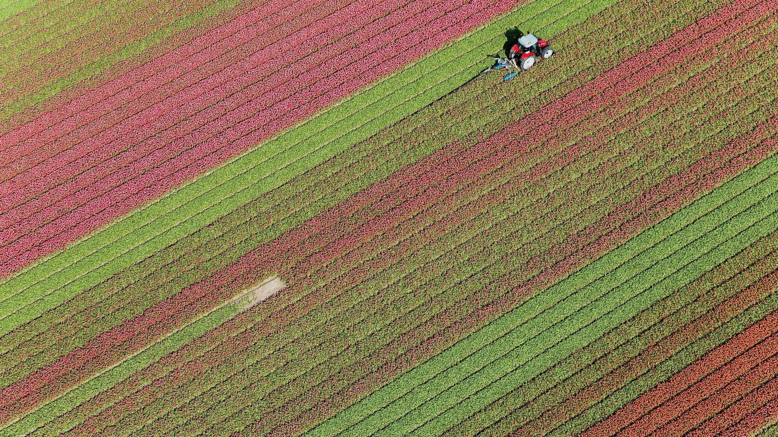

Intel® Unnati Industrial Training – 2025 Image Sharpening Using Knowledge Distillation Team CodeShamshers

Slide 2
Contents
Objective
Problem Overview
System Architecture
Teacher Model – SwinIR
Student Model - Lightweight CNN
Results

Slide 3
Objective
Develop a lightweight, real-time image sharpening model that enhances degraded images.
Use a Knowledge Distillation framework to transfer image restoration capabilities from a powerful teacher model to a compact student model.
Target applications requiring high visual quality with minimal computational overhead.

Slide 4
Problem Overview
Image degradation is common due to downscaling, compression, and data loss.
High-capacity models like SwinIR perform well but are computationally heavy.
There's a demand for fast, lightweight models that can restore visual clarity efficiently.
Our solution: Use knowledge distillation to build a student model that matches the quality of a large model but with high speed and small size.

Slide 5
System Architecture
The core design of our project follows a Knowledge Distillation (KD) approach where a powerful teacher model (SwinIR-M) transfers knowledge to a lightweight student model, enabling the student to perform high quality image sharpening efficiently.

Slide 6
Teacher Model - SwinIR
Architecture: Transformer-based with shifted windows
Pretrained on: Super-resolution, denoising, compression artifact removal
Advantages:
Captures global and local context
Produces sharp, high-fidelity results
Role:
Generates target images and features
Guides student during training
Used Weights:
001_classicalSR_DF2K_s64w8_SwinIR-M_x4.pth

Slide 7
Student Model - Lightweight CNN
Architecture:
Input: 3-channel RGB
Multiple Conv layers (3x3 kernels + ReLU)
Output: Sharpened 3-channel RGB
Features:
Small parameter count
Optimized for speed and deployment
Learns from both image and teacher guidance
Goal: High accuracy + real-time FPS

Slide 8
Results
SSIM: Achieved >90% average on test images
FPS: Student model supports 30–60 FPS at 1920x1080 resolution
Visual Outputs:
Sharpened images preserve edges, textures, and clarity
Close resemblance to teacher output
Qualitative & Subjective Evaluation: Positive feedback on visual fidelity

Slide 9
Demo & Links
Video Demo:
https://drive.google.com/file/d/1-YpXPAzRGb2ttBHt1tPqgmO2a3XKZK8d/view?usp=sharing

Slide 10
Thank You

